Slide 1
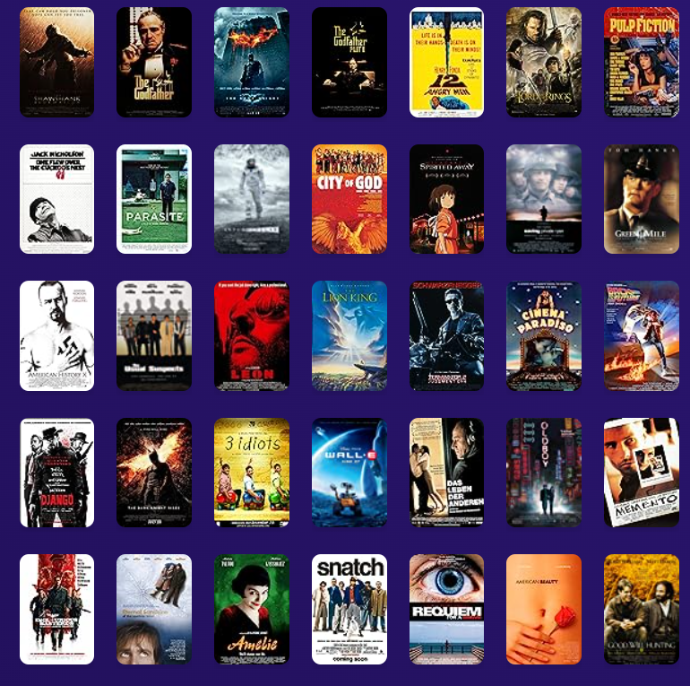
IMDB Movies dataset Kaggle
By:
Maliha Mukhtar
Mohammed Zayan
Temitope Ajose- Adeogun
Kaj Kabilan
Shavez Hussein

Slide 2

Table of Contents
Introduction
Project structure
Choosing Dataset
Cleaning IMDB Dataset
Loading to a Database
Using flask
Designing the HTML pages
Dashboard
Chart.js
Visualisations
Data Scraping & API (box office mojo by IMDbPro)
Challenges
Conclusion
Questions

Slide 3

Introduction
We are thrilled to guide you through a fascinating exploration of the cinematic universe as we dissect the IMDb dataset. Our journey takes us from Kaggle, where we extracted valuable insights, to the meticulous process of cleaning and storing data using Flask. But that's not all! We've also ventured beyond Kaggle, scraping data from Box Office Mojo, and leveraged geo APIs to map the global impact of movies.

Slide 4
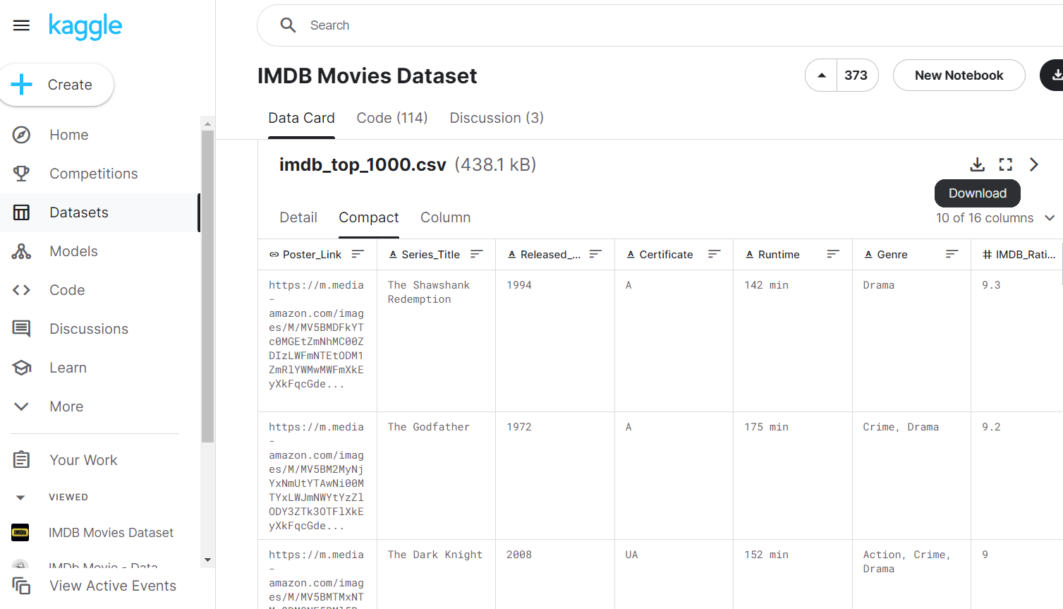
IMDb Dataset(Kaggle)
IMDb, a trusted source in the film industry, provides a comprehensive dataset with diverse information, including ratings, reviews, gross revenue, and release details.
This dataset has 1000 rows and 16 columns. The columns we will be focusing on in this project are the Ratings,
Ratings distribution, revenue, votes.

Slide 5
Project Structure
Project 3
Data
Database: SQLite
IMDb
Static
Templates
App
IMDb_top_1000
DF
CSS
JS
Jupyter
HTML
Dashboard
Index
BMO
Map
Search results
Movie details
Dashboard
Style

Slide 6
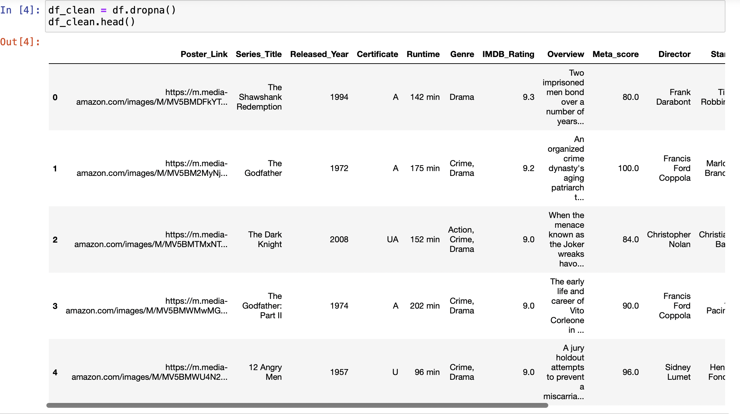
Cleaning IMDB Dataset

Slide 7
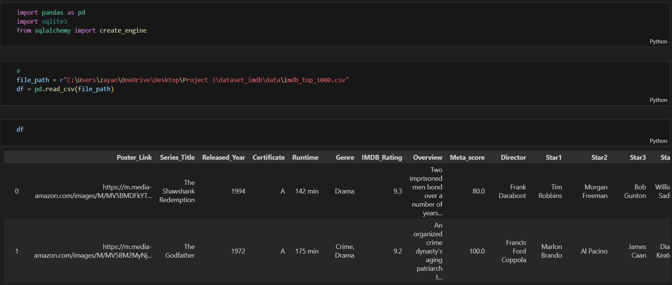
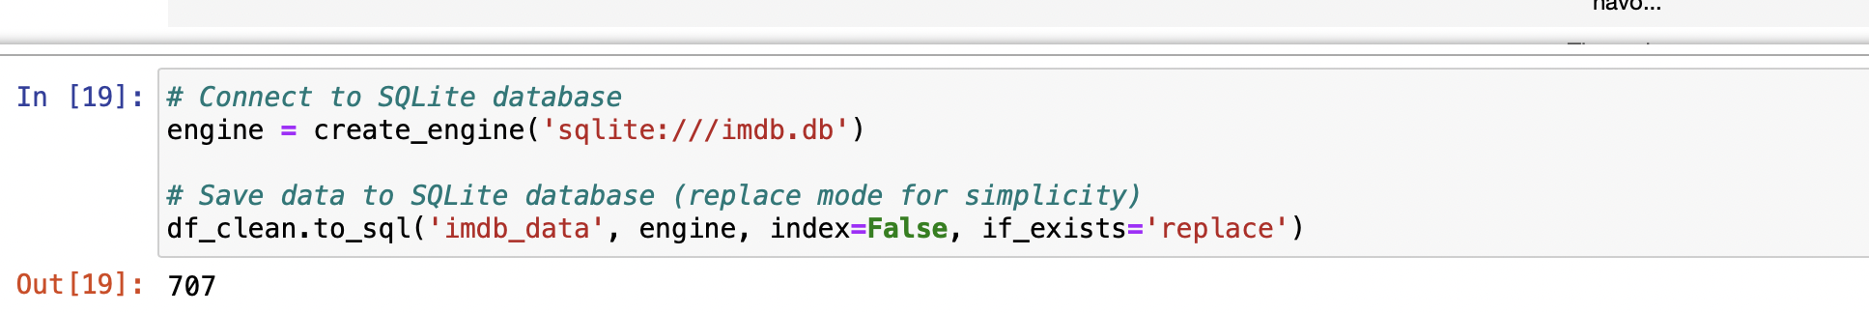
Loading to a Database: SQLite
We extract information from our base dataset and structure the data into a coherent DataFrame for efficient analysis.
We implemented Flask to create a robust API for seamless interaction with the IMDb Top 1000 dataset.
We exported it to SQLite and tested the database in Jupyter Notebook

Slide 8
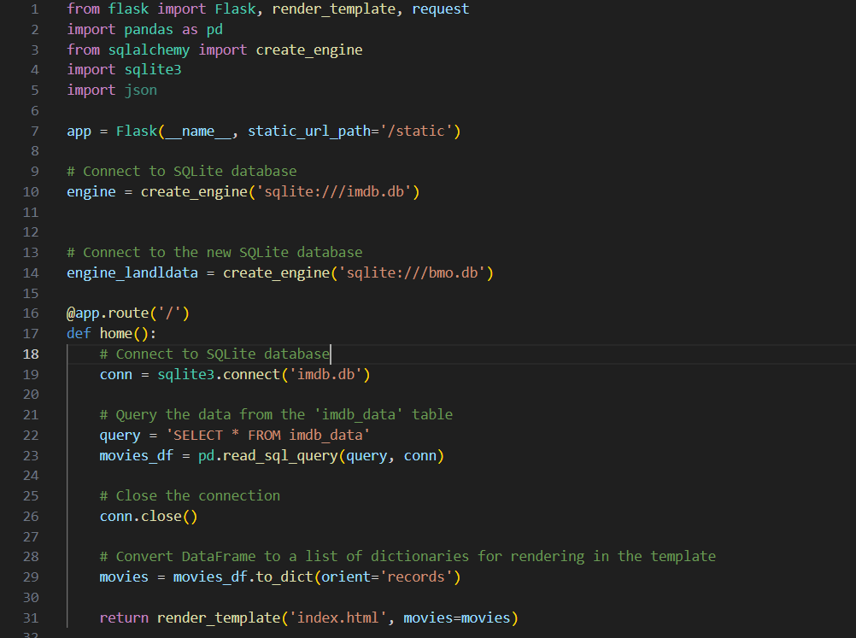
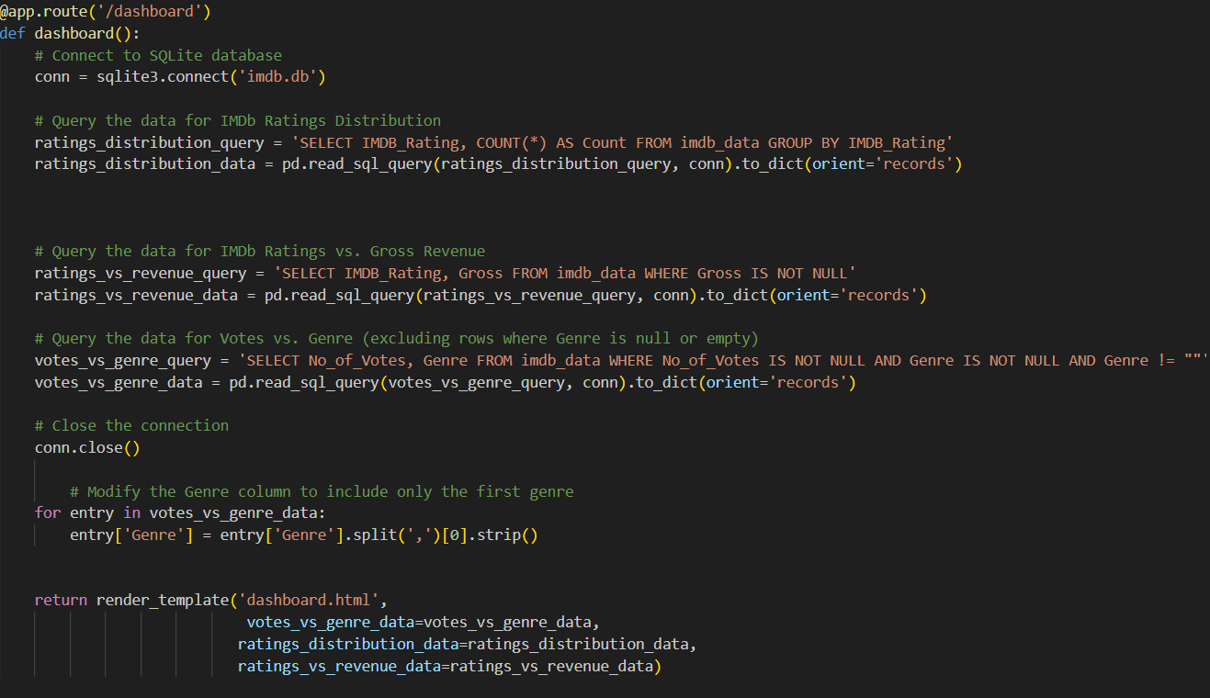
Database Integration with Flask
Once we had our pristine data, the next step was to provide it with a home. We chose Flask, a powerful web framework for Python, to not only host our cleaned dataset but also to create a seamless connection with a database. This integration allows for efficient data retrieval and manipulation.

Slide 9
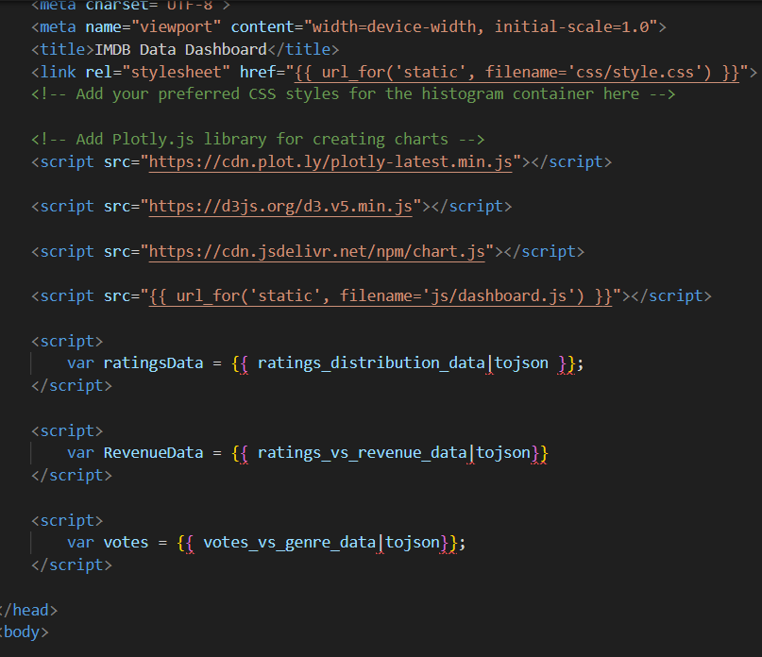
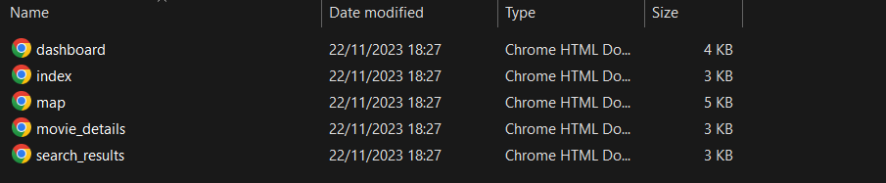
Designing the HTML Pages
As shown in our project structure, we have 5 HTML pages under our template folder.

Slide 10
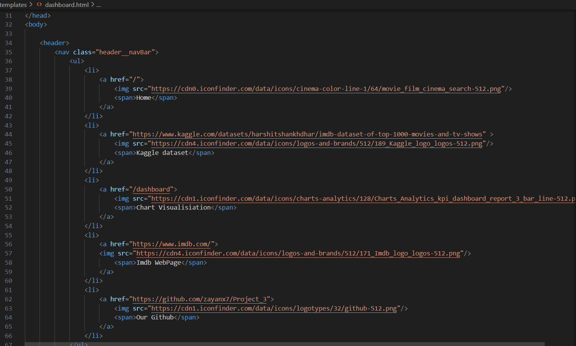
Dashboard HTML
We called the Javascript files and HTML pages we created to tie this all in together
Added links in the top bar to link to the other HTML files we created.

Slide 11
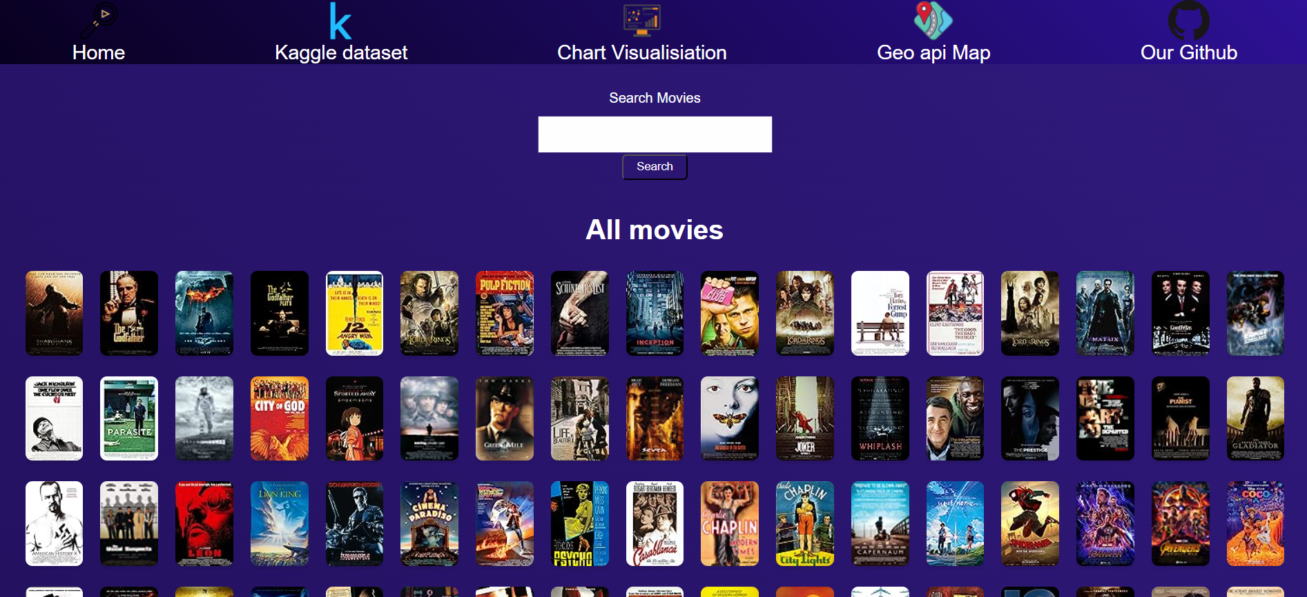
Home Page
Upon executing our HTML pages, this is the finalized appearance of our homepage, featuring a streamlined interface complemented by an intuitive search box for efficient data exploration.

Slide 12
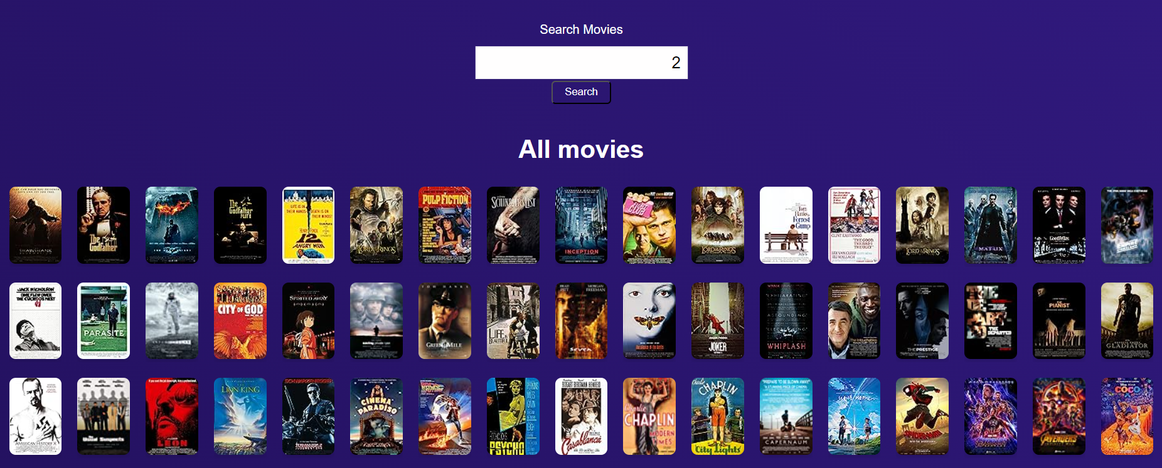
We incorporated a search bar to enhance navigation for ease of use.
Search Bar

Slide 13
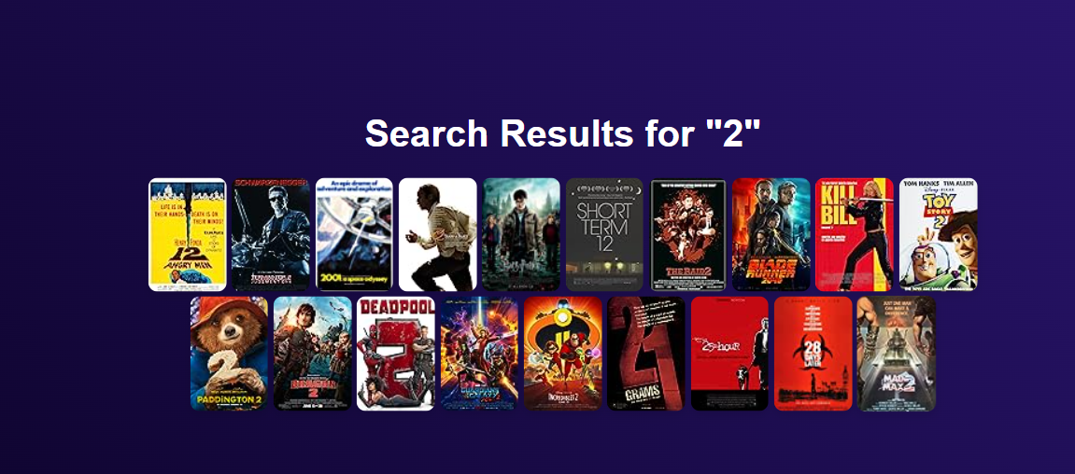
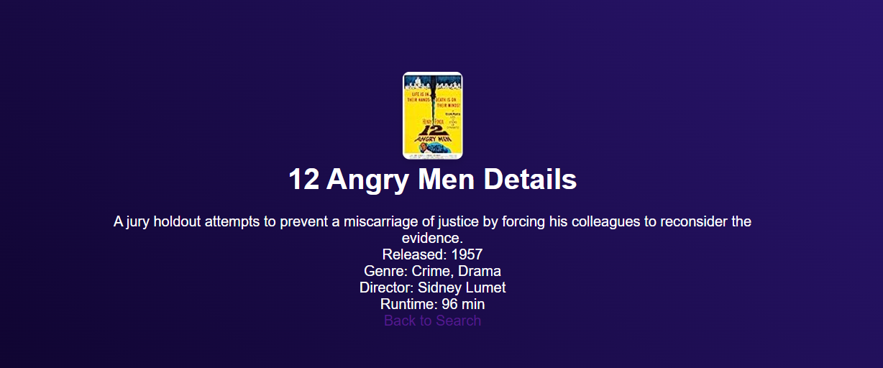
If we input “2” into the search box, it fetches all the movie titles that has 2 in them.
if we further click on a single movie that has retrieved in the results, it will show you a shot synopsis, the release year, genre, director and runtime.

Slide 14
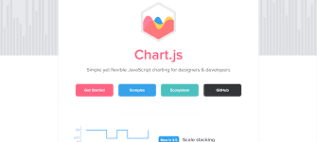
Chart .JS
Chart.js Overview:
- JavaScript library for interactive and dynamic charts.
- Simplifies data visualization with an easy-to-use syntax.
Why Chart.js:
- Excellent rendering and performance across all modern browsers.
- Chosen for its simplicity and flexibility.
- Offers a range of chart types and seamless integration for our IMDb ratings distribution visualization.
User-Friendly:
- Ideal for creating clear and aesthetically pleasing charts.
- Enhances the user experience in understanding complex data distributions.
Responsive Design:
- Adapts seamlessly to different devices and screen sizes.
- Enables a consistent and visually appealing display across various platforms.
Installation :
//Using NPM
npm install chart.js

Slide 15
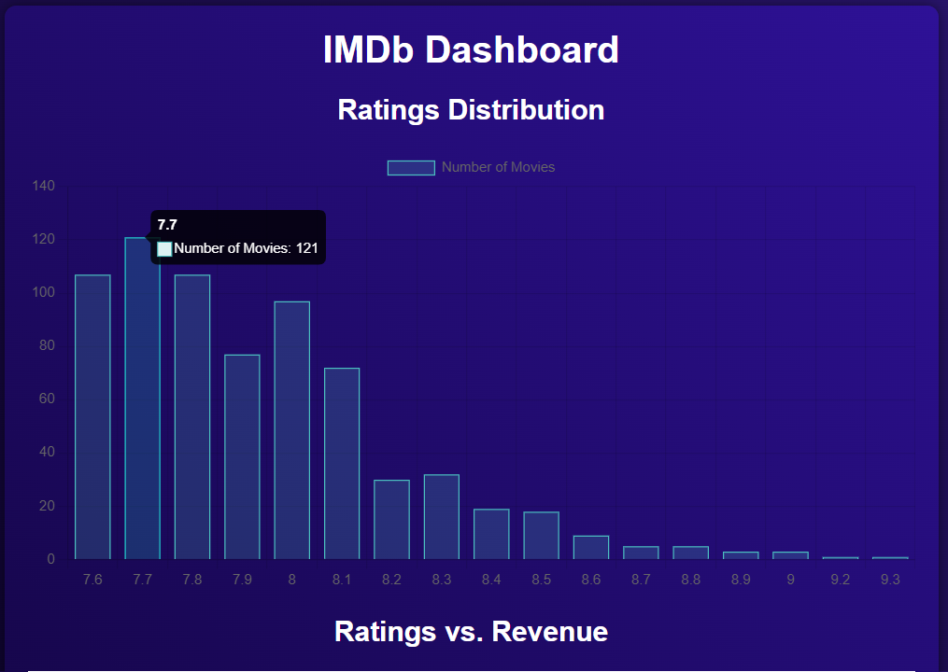
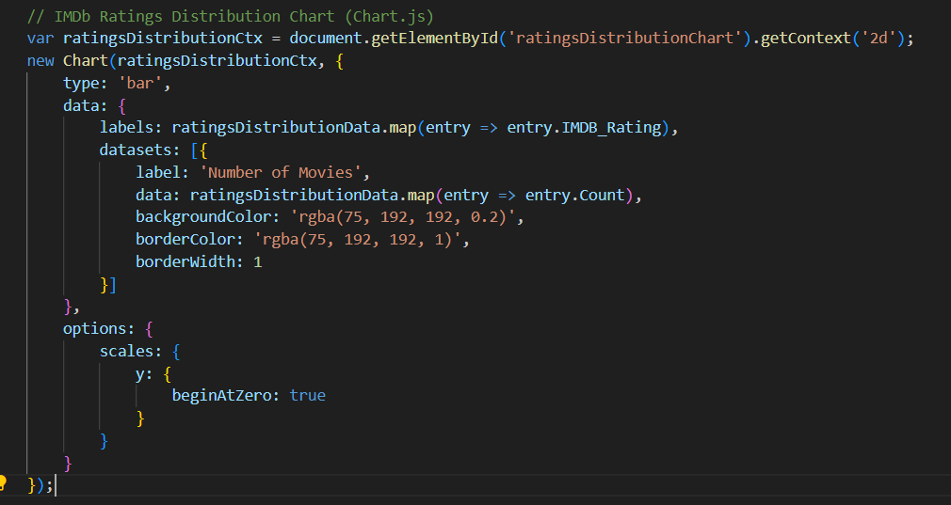
Ratings Distribution Chart with Hover Interaction
(Chart.js)

Slide 16
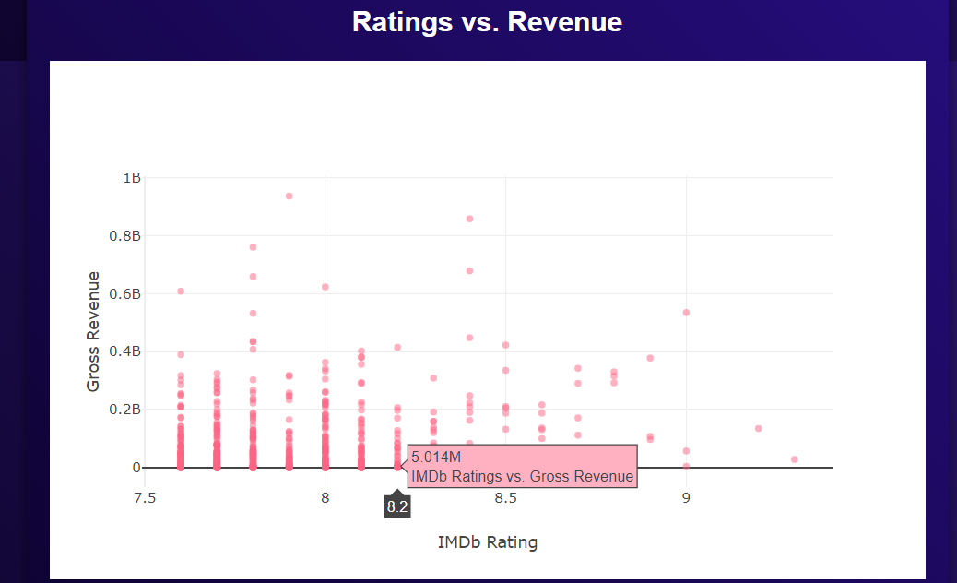
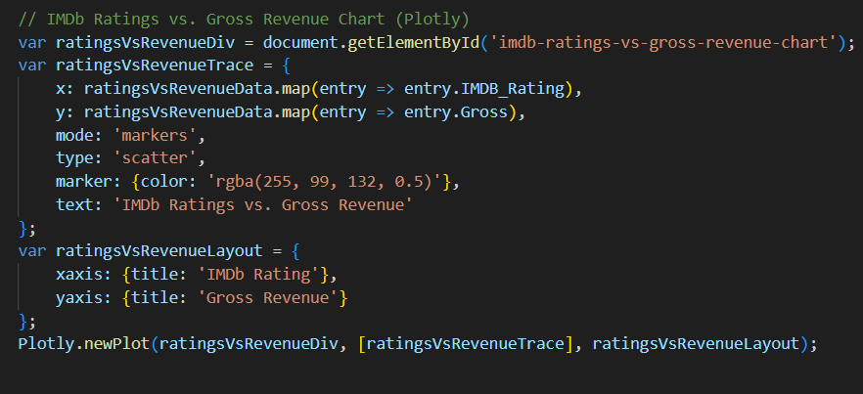
Plotly Ratings vs. Revenue

Slide 17
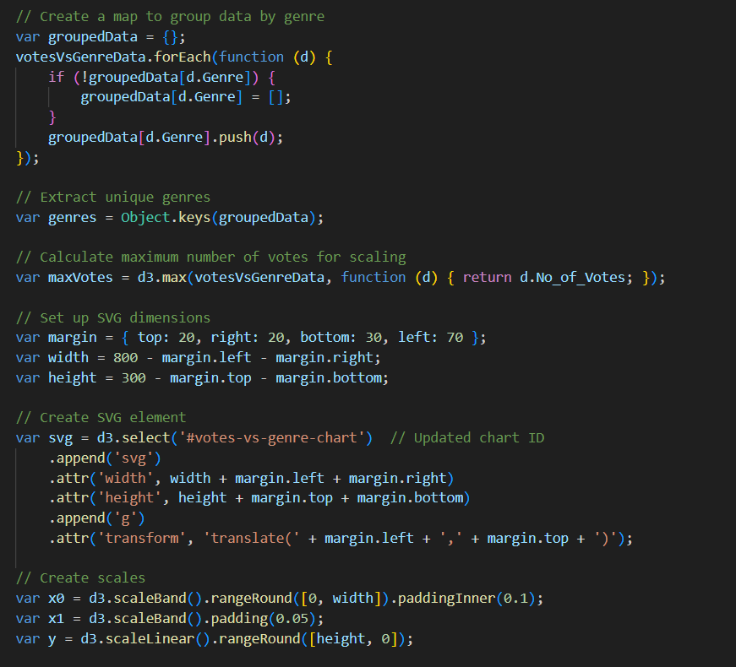
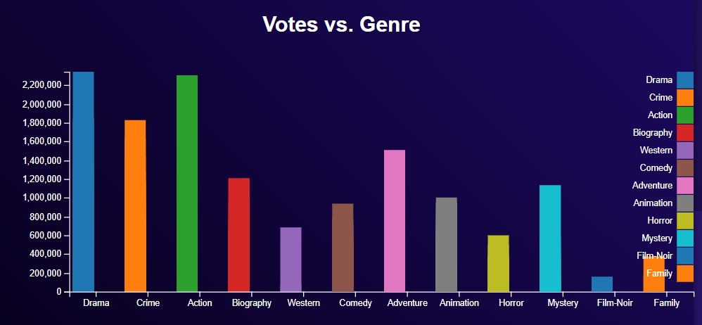
D3.js Votes vs. Genre
Installation: // Using NPM npm inst d3

Slide 18
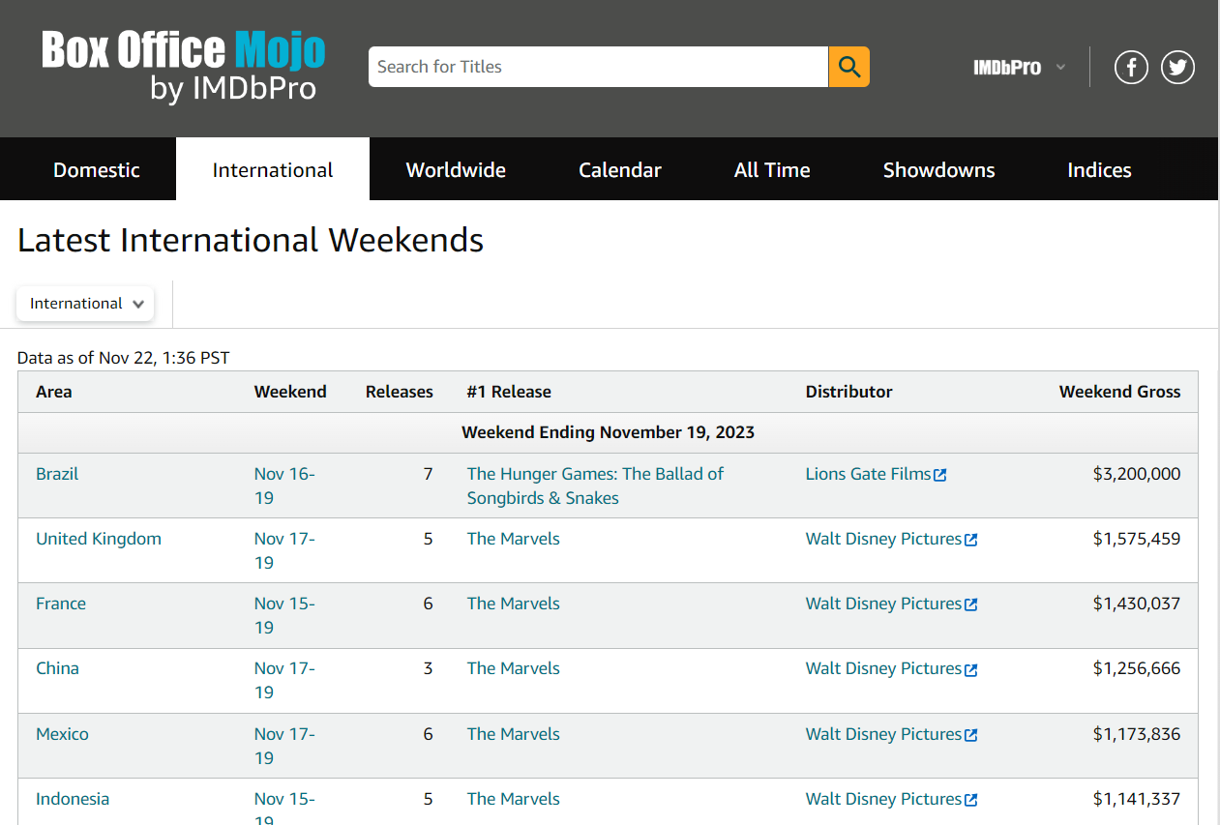
Data Scraping & API (box office mojo by IMDbPro)
Expanding our horizons, we didn't stop at Kaggle. We ventured into the realm of Box Office Mojo, scraping additional data to enrich our analyses.

Slide 19
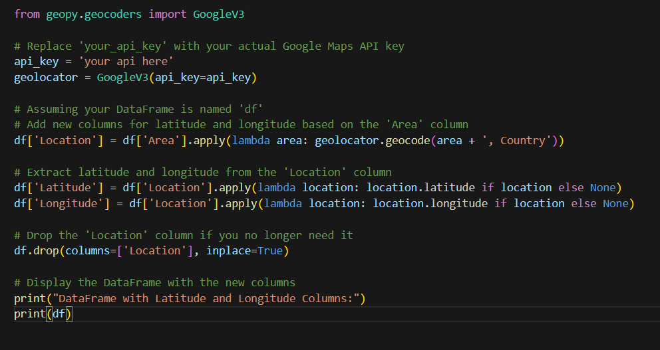
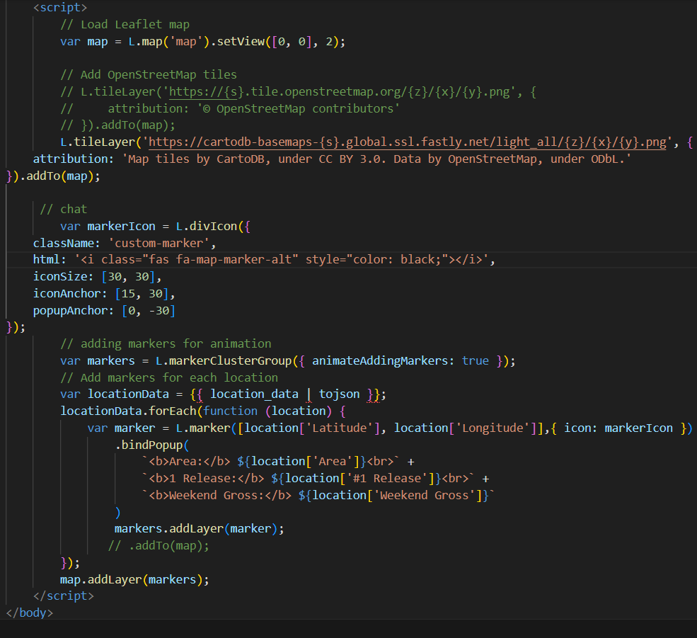
Data Scraping & Geo API (box office mojo by IMDbPro)
Geo API was used to retrieve the latitude and longitude for all the countries within the area column
Every pop-up marker displays the information on movie name, country and weekends Gross

Slide 20
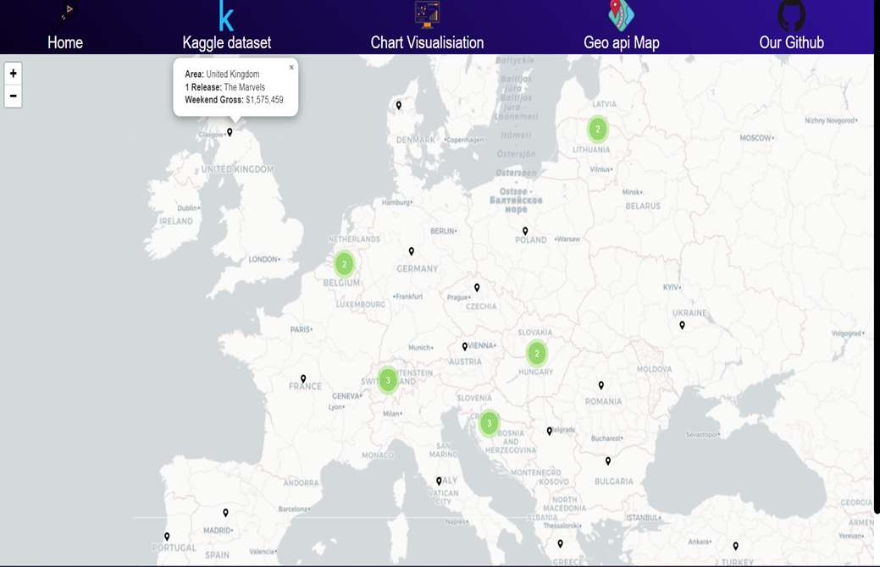
Map

Slide 21
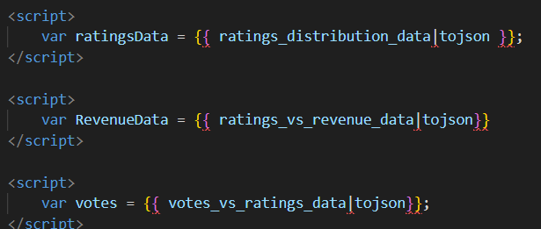
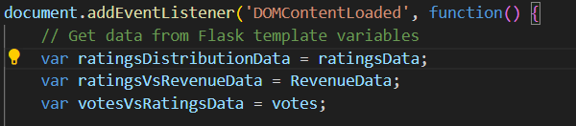
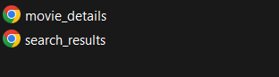
Challenges & Consideration
JavaScript Variable
Challenge: for some reasons we couldn’t define the variables in our JavaScript file
Consideration: To fix this, we defined the variables in the html file and called them in JavaScript
Refining Movie Details Route :
Challenge: Initially, we created a route for the movie details linked to the search bar. However, later realized that this setup would exclusively search for movies.
Consideration: To address this limitation, we established an additional route for search results. This route queries all data matching the search criteria and presents it on a separate template named "search results”.

Slide 22

Conclusion
Overall, a good insight on the relationships between various factors that influence movie success such as ratings, reviews and the revenue.
With more time we could have Combined other datasets that may contain more specific details of the movies.
We could have also found a way to loop in updated popular movies for our api so its constantly refreshing and updating.
Thanks for listening , Questions?

Slide 23

Thank You
Questions

